Slide 1
Python Coding

Slide 2
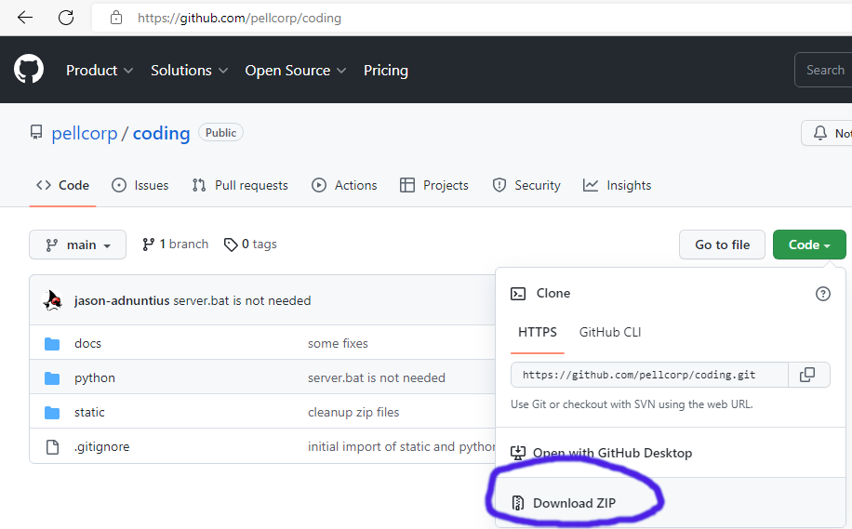
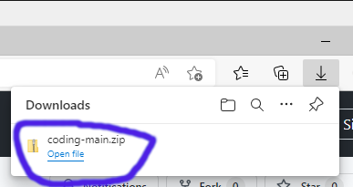
Getting the Sample Code
Open Chrome or Edge and navigate to: https://github.com/pellcorp/coding
Click the green Code button and then the Download ZIP button
Click open file for coding-main.zip in the browser download window.

Slide 3
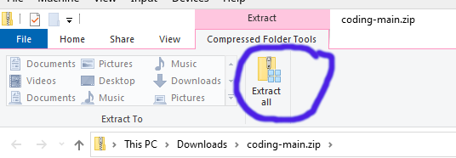
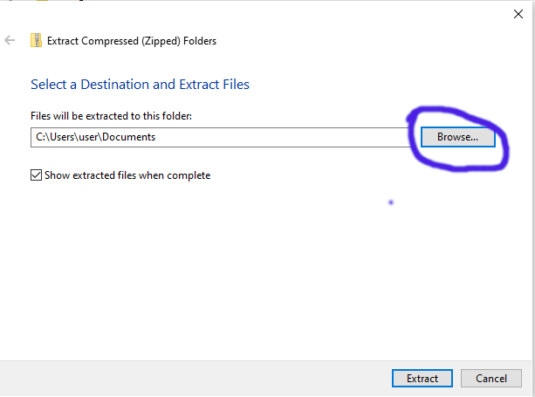
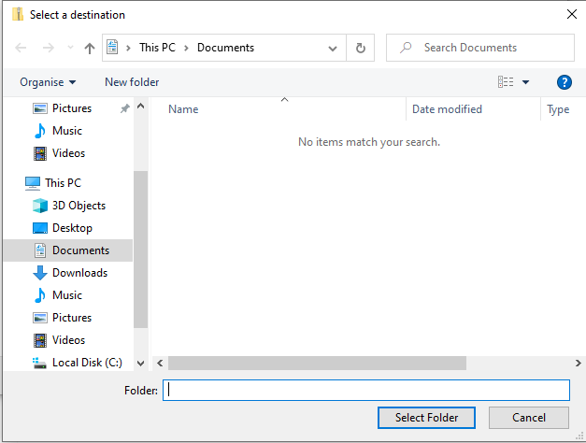
Getting the Sample Code Cont.
Click the Extract all button
When Prompted to Select a Destination and Extract Files, click the Browse… button
And choose your School Drive Folder
Click Extract

Slide 4
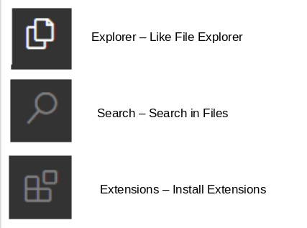
Visual Studio Code (VSC)
Visual Studio Code is also a text editor
But it also makes it easy to run our python scripts directly.
There a few important parts of Visual Studio Code you should familiarise yourself with.
Important buttons:
Don’t worry too much about the others for now

Slide 5

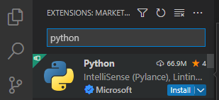
VSC: Add the Python Extension
Start up Visual Studio Code
Click the Extensions button
Search for python and click the install button
And then Wait for it to finish installing
And that is it, once its done we will be able to do some python coding!

Slide 6


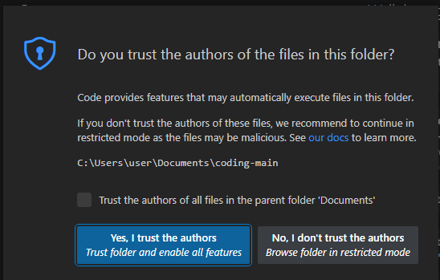
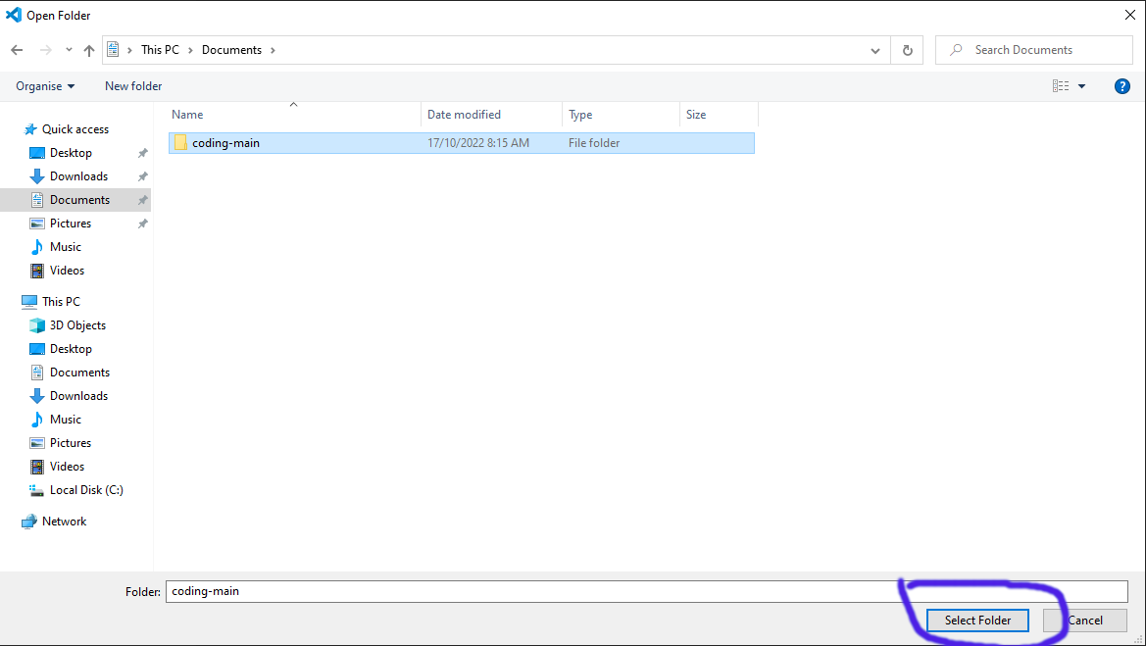
VSC: The Sample Code
Click the Explorer button
Click the Open Folder button
Navigate to the coding-main folder you extracted earlier into your School Drive Folder
Click Select Folder
In the next window, Click the Yes, I trust the authors button.

Slide 7
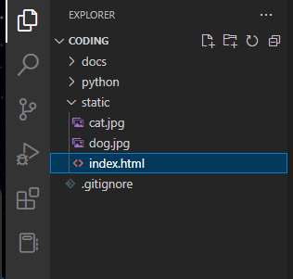
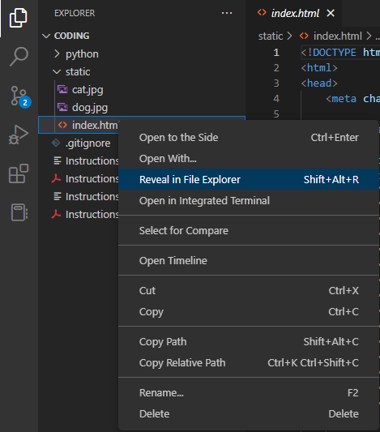
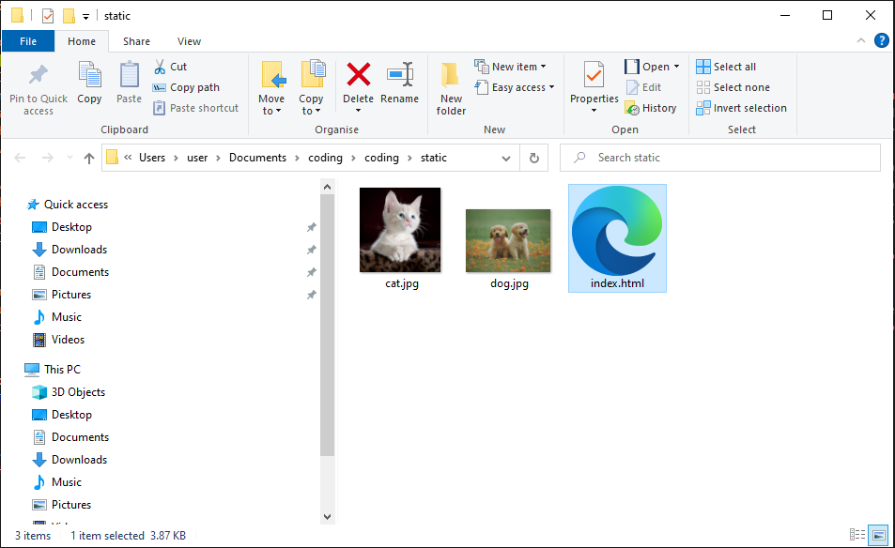
VSC: The Sample Code Cont.
A handy feature of VSC is to Reveal in File Explorer.
Right click on the static index.html and click Reveal in File Explorer
You should see this now:

Slide 8
What is Python
A programming language which is very popular, especially for beginners.
We are going to learn by doing, including playing with and changing sample code.
Output – printing to the console
Variables
Conditional Statements
Loops

Slide 9
Python - Variables
Strings
  “Hello World”
Integer Numbers
  Are whole numbers, numbers without decimal points
Floating Point Numbers
  Are numbers with a decimal points.
Booleans
  True or False
  Boolean arithmetic
Lists
  A way to group variables into a structure, so that python can operate on their together, an example would be:
    states = [‘VIC’, ‘NSW’, ‘TAS’, ‘SA’, ‘NT’, ‘QLD’, ‘WA’]
Dictionary
  A way to store key value pairs in sometimes quite complicated ways.
  They is always a string, the value can be any of the other types, including a nested dictionary.

Slide 10
Output, Conditions and Loops
Print() for printing stuff to the console
We are going to be using if statements:
  if condition
  elif condition
  else
We are going to be using for loops, to loop through lists and dictionaries
  for value in list
  for key in dictionary

Slide 11
Running Python from VSC

